Slide 1
HELLO
EVERYONE
PROJECT-03
SOCIAL MEDIA
RISHAB SEN
ROHIT PRADHAN
TUSHAR SINGH

Slide 2
INTRODUCTION.
DATA COLLECTION &CLEANING.
DATA ANALYSIS.
VISUALIZATION.
INSIGHTS.
1
2
3
4
5

Slide 3

Introduction to a Social Media Project for Data Analytics:
Social media platforms have become integral parts of our daily lives, generating massive amounts of data every second. Leveraging this data through analytics can provide valuable insights into user behavior, preferences, and trends. A social media data analytics project aims to extract meaningful information from the vast volume of data.
Key Components:
1. Data Collection.
2. Data Cleaning and Preprocessing.
3. Exploratory Data Analysis (EDA).
4. Visualization.
5. Continuous Monitoring and Optimization.
Notes:
Introduction

Slide 4
Data collection is an important step in any data analytics project, so the database we are working on has been received from Geekster.com which is for the study purpose.
First we took this database in MYSQL, then created a schema, ran a query and created tables.
Then we connected the MYSQL to PowerBI, in which we had some issues but we connected the data to both applications, after that we cleaned the data in PowerBI, whose steps are as follows:
Data cleaning is the most important because if the data is not clean, if there is a duplicate value in it, then your insight will also be wrong, so now our data is completely clean, now we will analyze the data and extract the insights and visualize.

Slide 5
Data Analysis (DA):
Explore data distributions, correlations, and basic statistics.
Identify patterns and outliers that may impact analysis.
1. Design and implement a robust database schema that efficiently stores social media-related data.
2. Develop SQL queries to establish clear connections between different activities on the social media platform.

Slide 6
Visualization:
Use data visualization tools to present insights in a clear and understandable manner.
Create dashboards for real-time monitoring of social media metrics.
To visualize and analyze the insights generated from the Social Media Database, we have created a Power BI dashboard. This dashboard incorporates key metrics and visualizations derived from the data stored in the database.
1. Create a Power BI dashboard for visualizing key insights derived from the database.
2. Provide detailed analytics on user
engagement, content interactions,
and media consumption patterns.

Slide 7
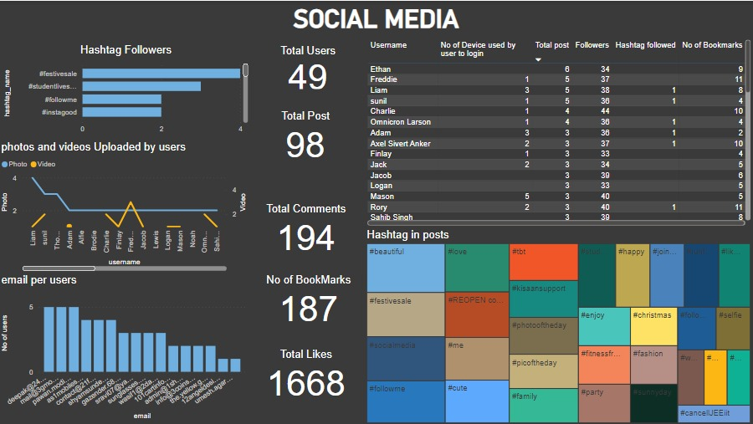
INSIGHTS : The insights that have come out after Analyze the data are as follows:
Count of photos and videos uploaded by each users.
Count of user id link with same mail address.
Count of hashtags used in different post.
Total number of users and posts.
Total number of comments and likes.
Total number of bookmarks.

Slide 8
THANK YOU
BY :-
ROHIT PRADHAN
RISHAB SEN
TUSHAR SINGH

